Slide 1
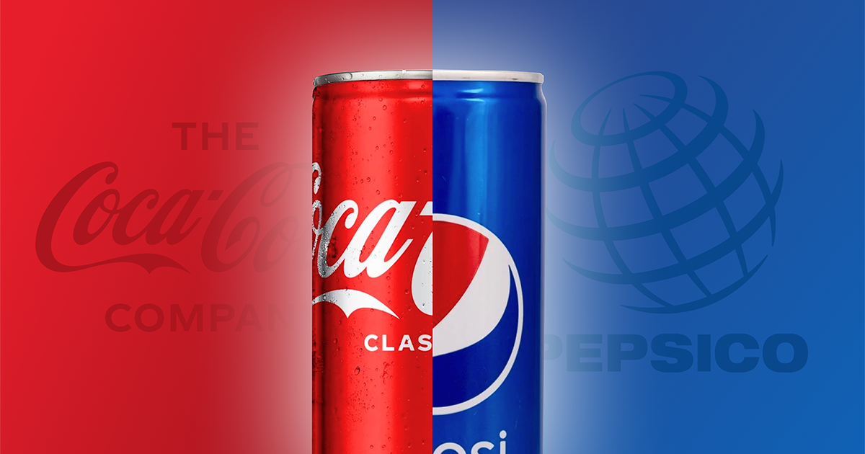

Understanding Pepsi and Coca-Cola
Trends, Sentiment, and Brand Fit 2024-11-22

Slide 2
Problem Statements
What People Are Talking About:
Find the common words and sentiment in discussions about Pepsi and Coca-Cola to see what people are interested in.
Matching Brand Identity:
Use an NLP model to predict if a message is about Pepsi or Coca-Cola and check if it matches each brand's mission.

Slide 3
Study Process
Extract Subreddit Posts from r/Pepsi and r/cocacola
Preparing Data
Exploratory Data Analysis
Sentiment Analysis
Vectorizer and Tokenizer
Model Tuning
Application

Slide 4
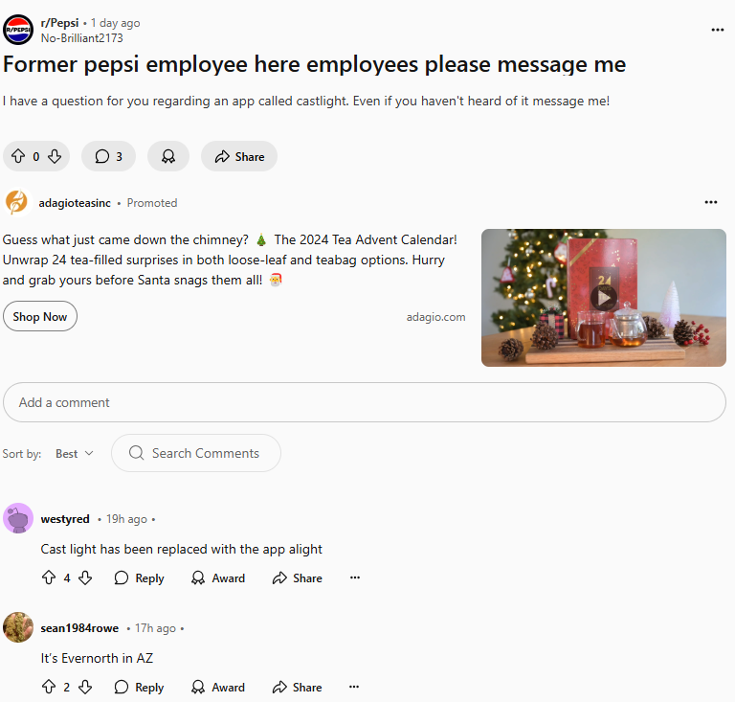
is_pepsi = 1
Title
Preparing Data
Body
Concatenate Title and Body
Create column is_pepsi
Lower text and remove related words; pepsi, pepsico, coca, cola, coke
Pepsi
995
Posts
Coca-Cola
963
Post

Slide 5
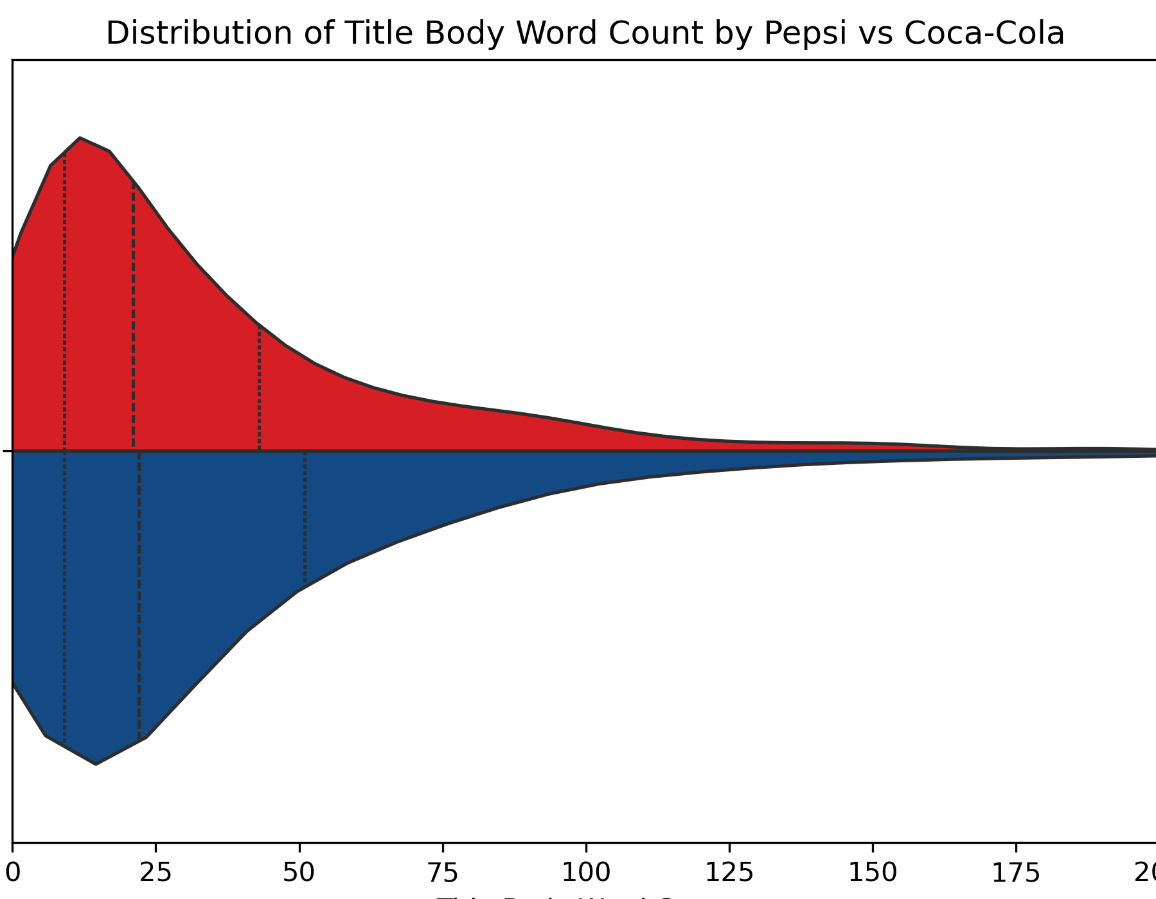
Exploratory Data Analysis
Q3 – 43 words
Word Counts
Similarities in Lower Quartiles
Differences in Higher Quartiles
Pepsi have more word counts than Coca-Cola
Coca-Cola
Pepsi
Q3 – 51 words

Slide 6
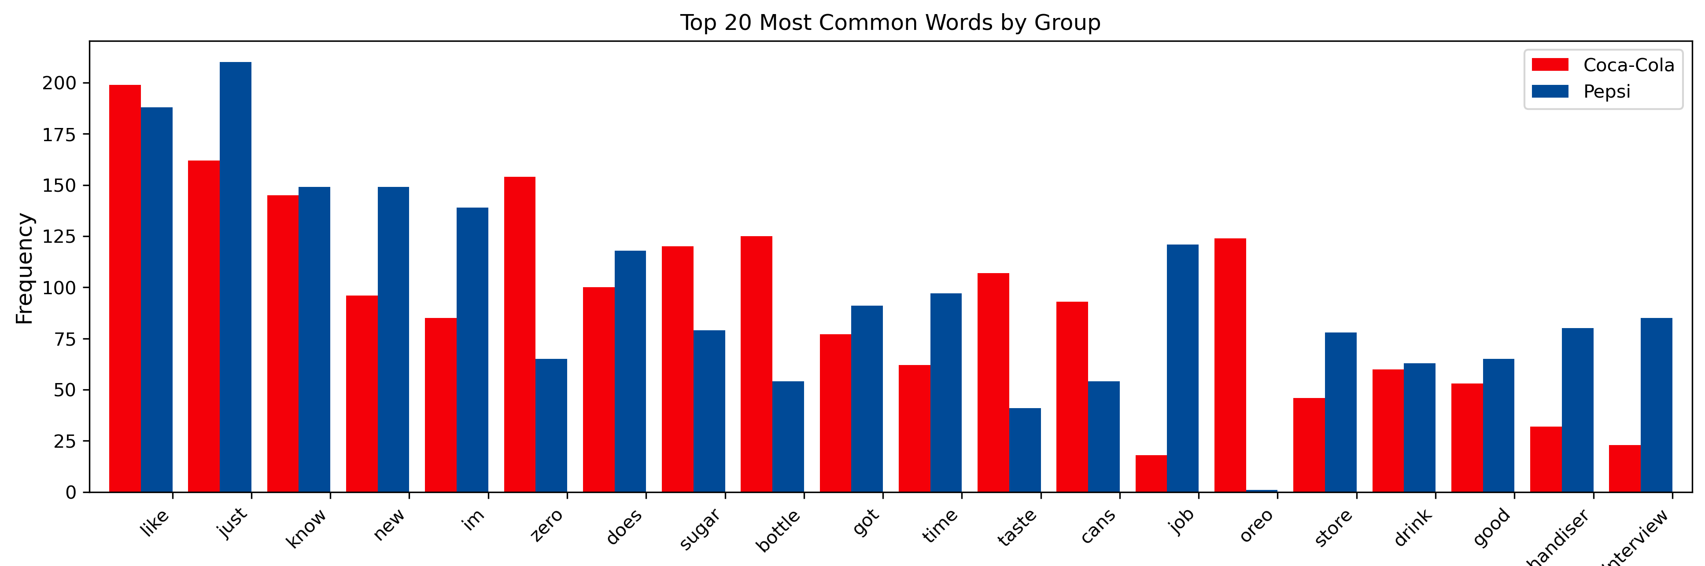
Exploratory Data Analysis
Common Words
Words that frequently show across all documents
Stopwords: like, just, know, new, im (I’m), does
Keywords: zero, sugar, bottle

Slide 7
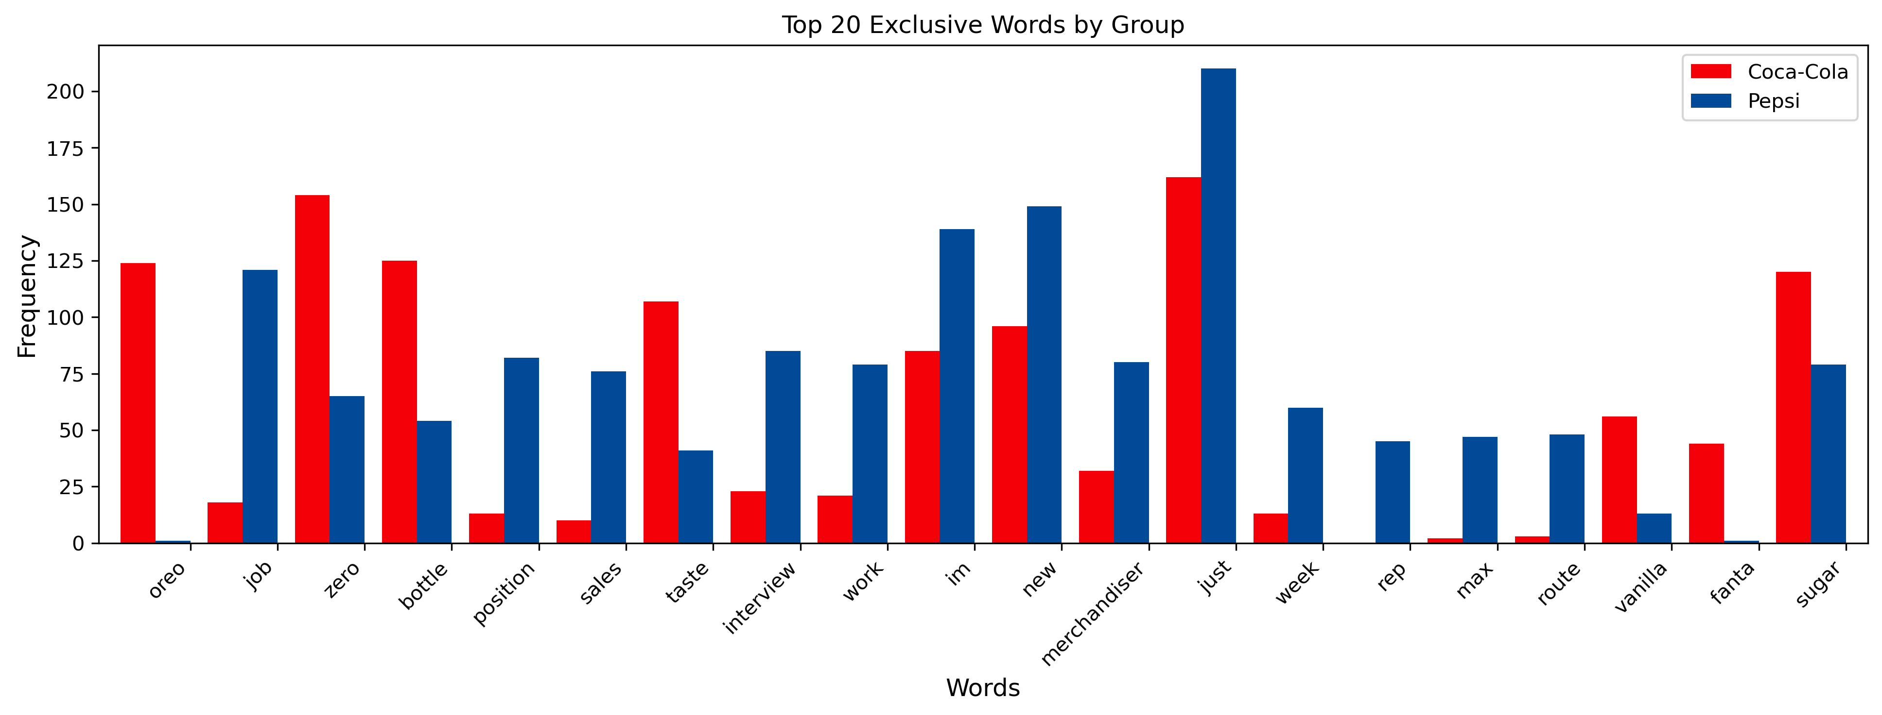
Exploratory Data Analysis
Exclusive Words
Words that mostly show either in Pepsi or Coca-Cola
Find the difference in the count of occurrences between Pepsi and Coca-Cola

Slide 8
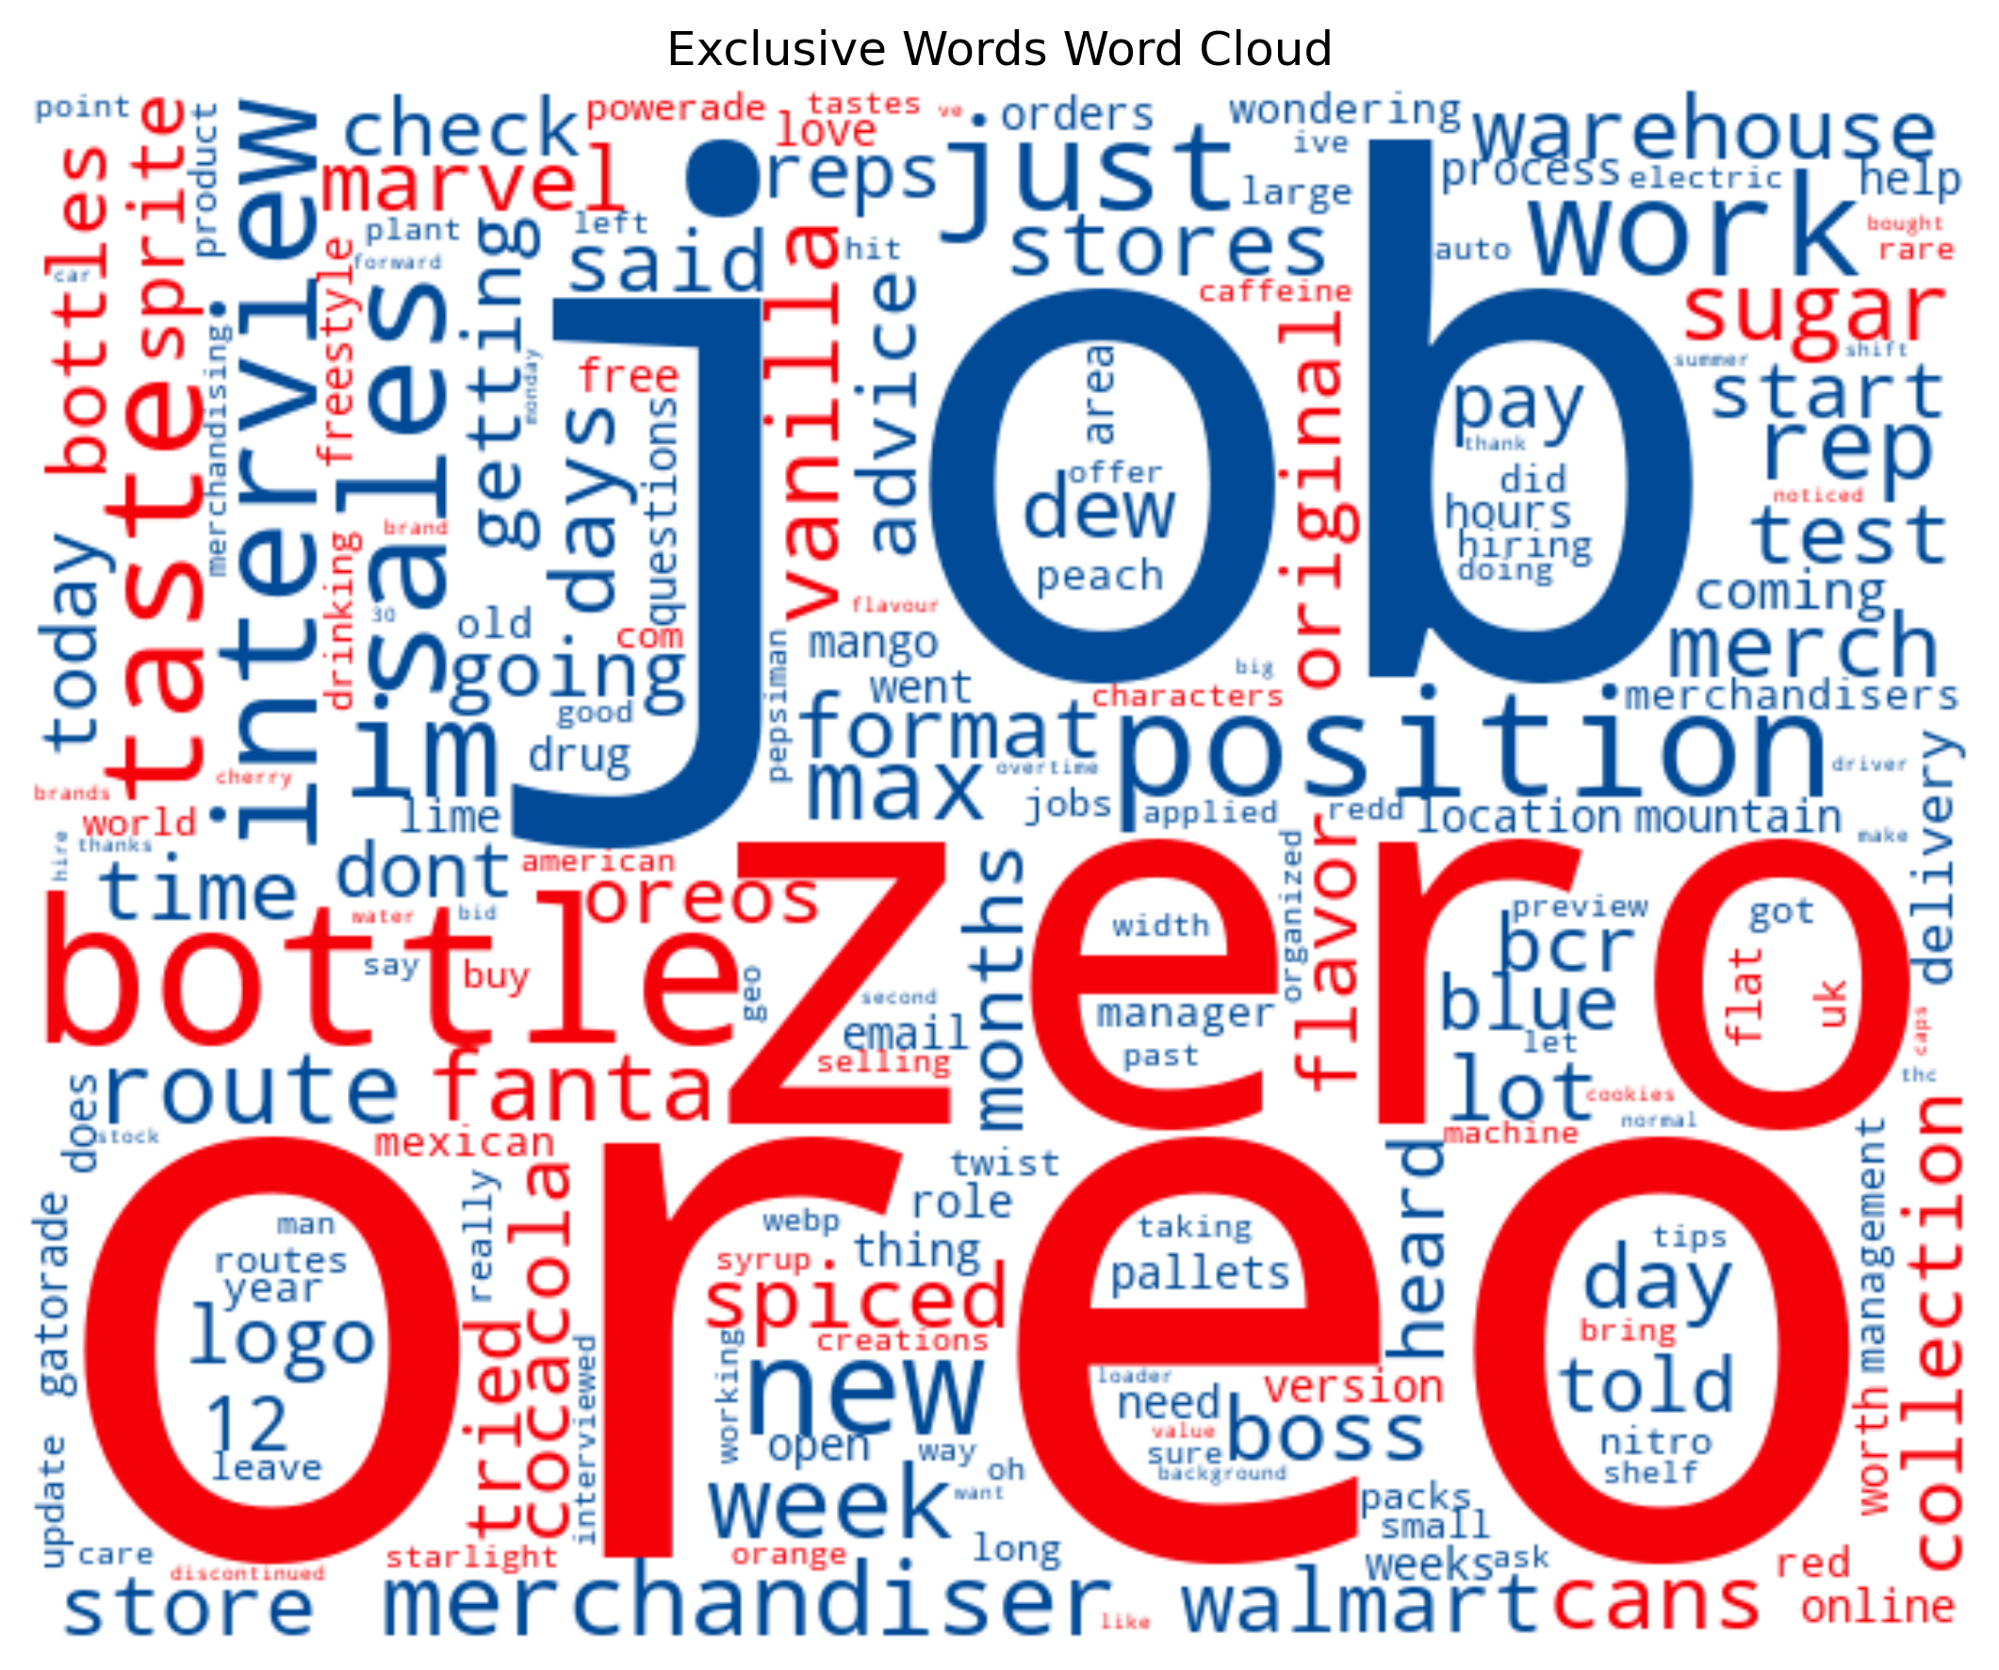
PepsiCo is closing 4 bottling plants and cutting nearly 400 jobs as it streamlines operations
#pepsi
Exploratory Data Analysis
Word Cloud
This word cloud displays words in red for Coca-Cola and in blue for Pepsi, with word size reflecting the difference in occurrences between the two brands
Never seen this kinda Coke bottle. Pretty fun IMO.
Does anyone have any info about this Coca-Cola Hip Hop bottle?

Slide 9
Pepsi
Coca-Cola
Sentiment Analysis
995
Posts
963
Post
454
Positive
477
Compound Score
Focus overall Sentiment
Sensitive to modifiers, negations, and emphasis
NPS Net Promoter Score
is a metric used to gauge customer satisfaction, range between -1 and 1
Score > 0.05
354
Neutral
323
- 0.05 <= Score <= 0.05
187
Negative
163
Score < 0.05
27%
NPS
33%
Positive - Negative
Total Posts

Slide 10
coca
Vectorizer &
Tokenizer
pepsi
cola
I, of, on, a, for, with, the, at, from, in, ?, ….
Preprocessing
Set all text to lowercase
Remove English stop words and related words with coca-cola and pepsi
coke
pepsico

Slide 11
coca
Vectorizer &
Tokenizer
pepsi
cola
Preprocessing
Set all text to lowercase
Remove English stop words and related words with coca-cola and pepsi
Stop Words
coke
pepsico

Slide 12

coca
Vectorizer &
Tokenizer
pepsi
cola
Preprocessing
Set all text to lowercase
Remove English stop words and related words with coca-cola and pepsi
Stop Words
coke
pepsico

Slide 13
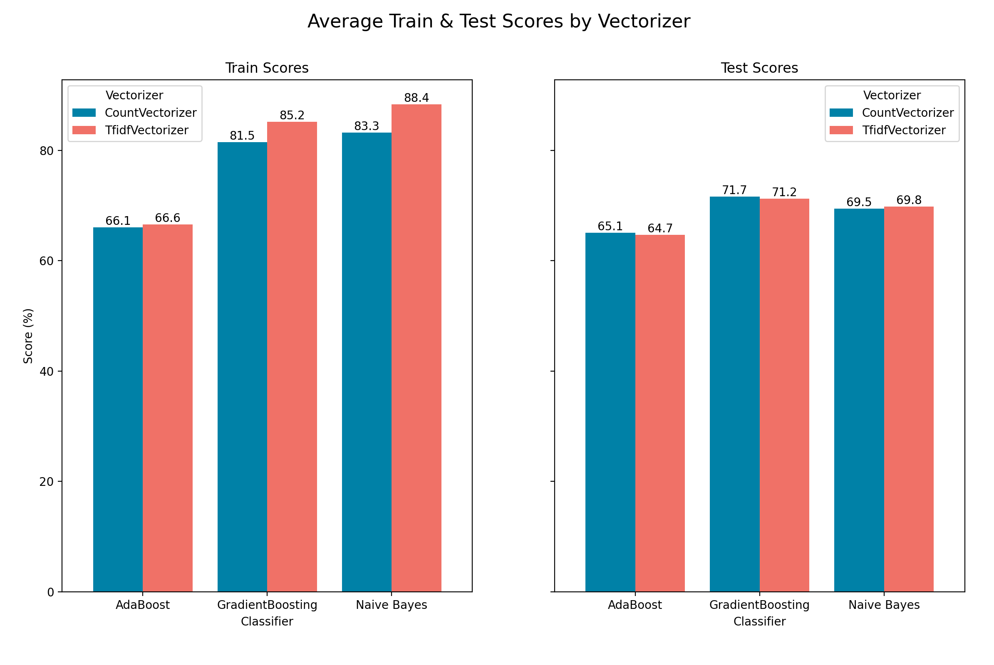
Type of
Vectorizer
Count vectorizer
TF-IDF vectorizer
The Train score increased
when using the TF-IDF vectorizer. But not impact with Test Score

Slide 14
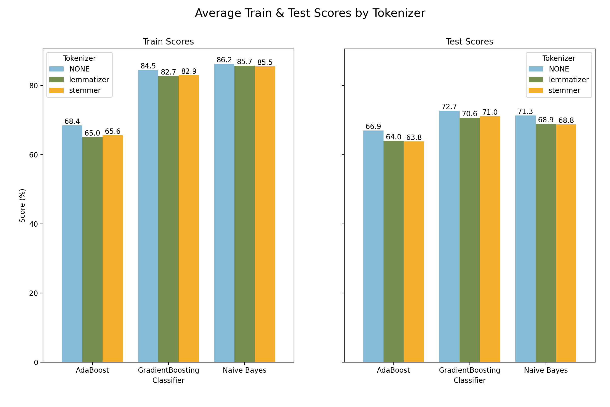
Type of
Tokenizer
None
Lemmatizer
Stemmer
Not using a tokenizer resulted in the highest scores for both train and test.

Slide 15
Other vectorizer
Parameters
However, for the Naïve Bayes Model:
n_grams
min_df
Max features
Max DF
Token pattern
These parameters did not affect the scores for any of the models.
(1, 1)
3
These parameters can help reduce the gap between training and testing scores, resulting in less overfitting.

Slide 16
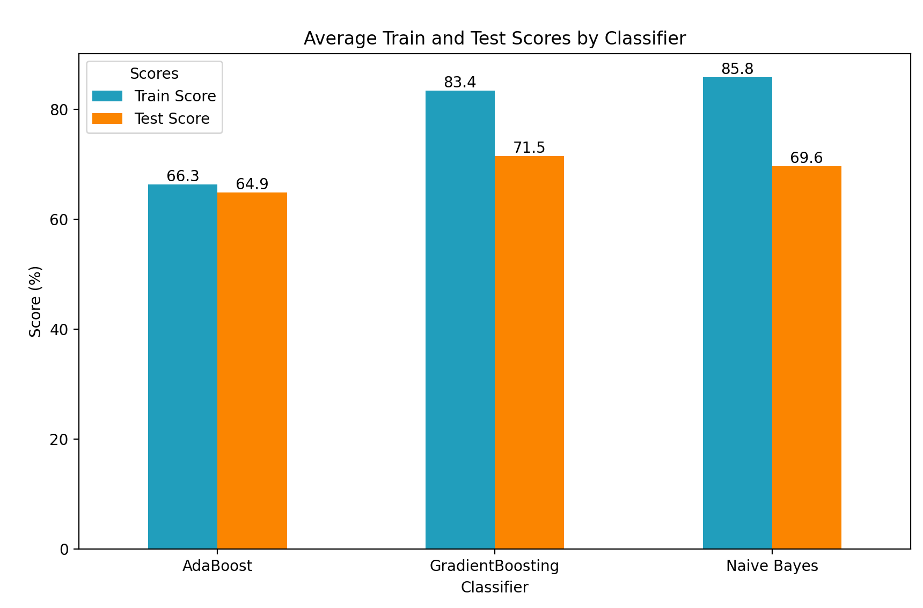
Type of
Classifier
AdaBoost
Gradient Boosting
Naïve Bayes
The highest train score : Naïve Bayes
The highest test score : Gradient Boosting
The least overfit : AdaBoost

Slide 17

<= 5000 unigrams
Best Parameters for tuning Gradient Boosting Model
Words appearing in at least 2 documents but in no more than 80% of all documents
Vectorizer Parameters
max_features = 5000
min_df = 2
max_df = 0.8
ngram_range = (1,1)
Model Parameters
n_estimator = 50
max_depth = 4
min_sample_leafs = 2
learning_rate = 0.3
50
0.3
Trees in model
At least
2 docs
learning rate

Slide 18
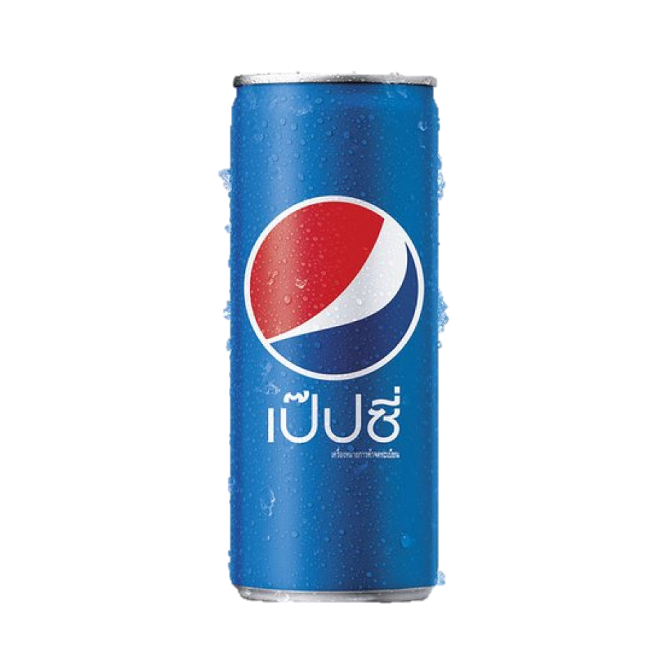
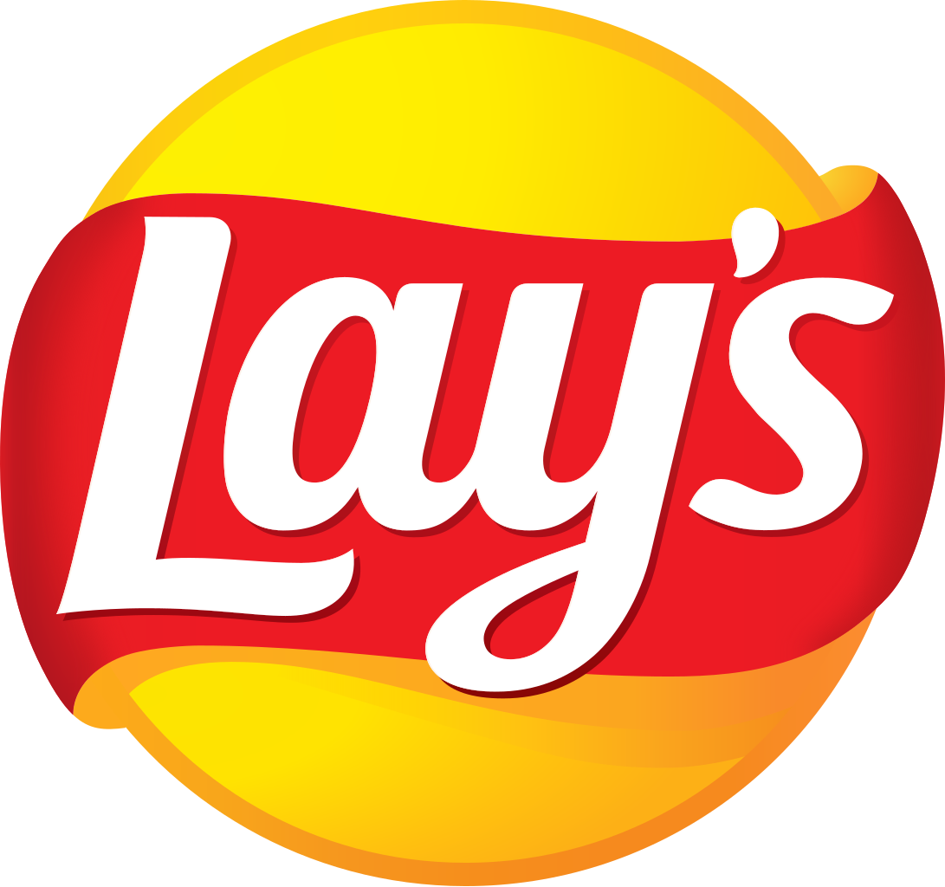
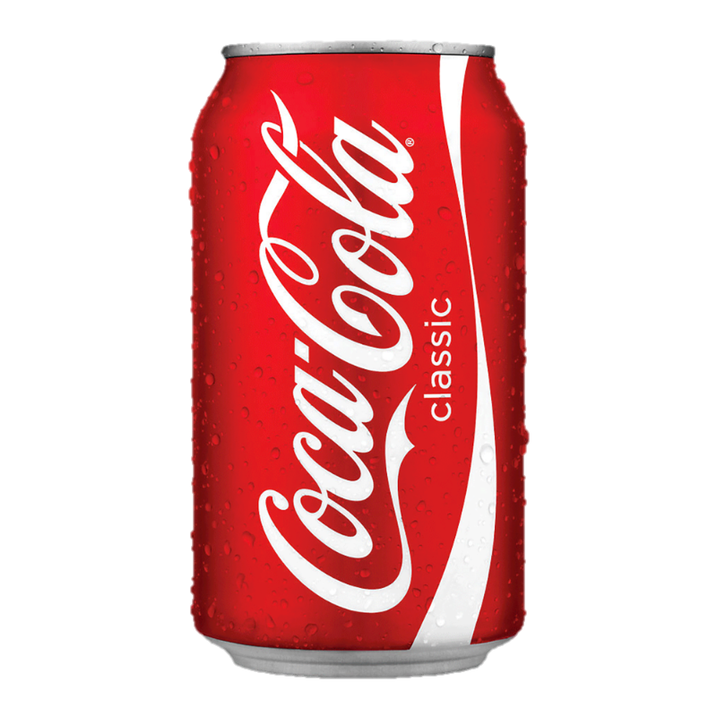
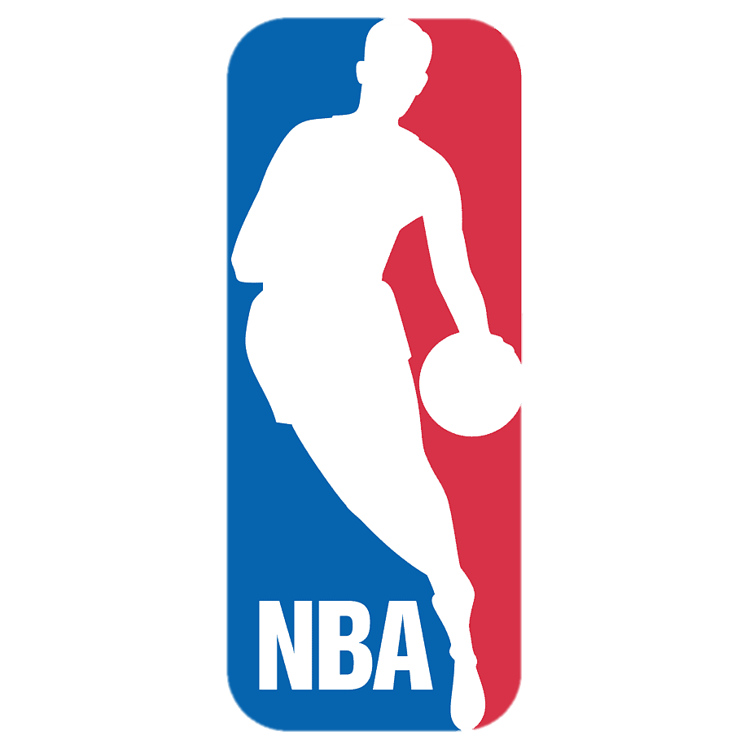
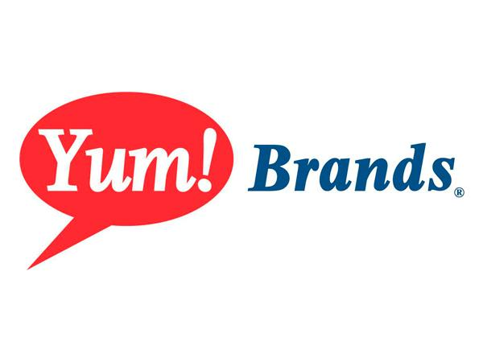
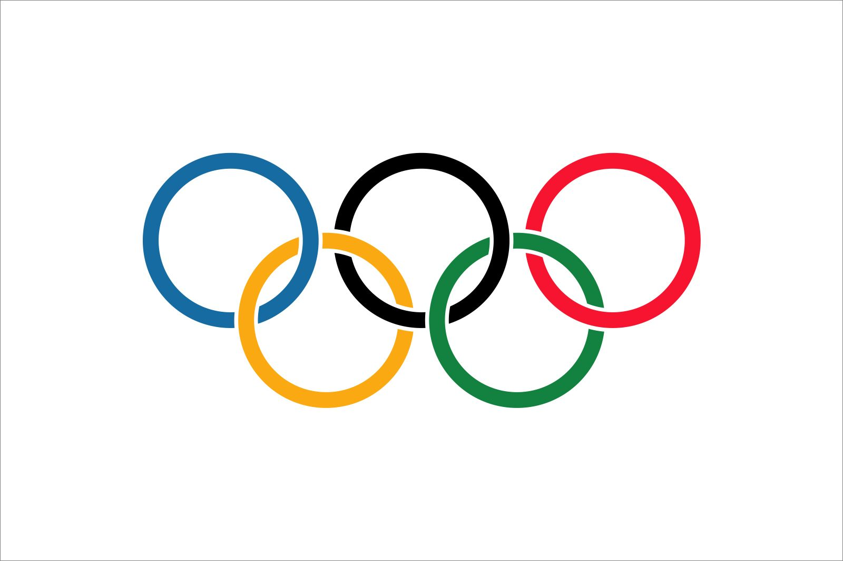
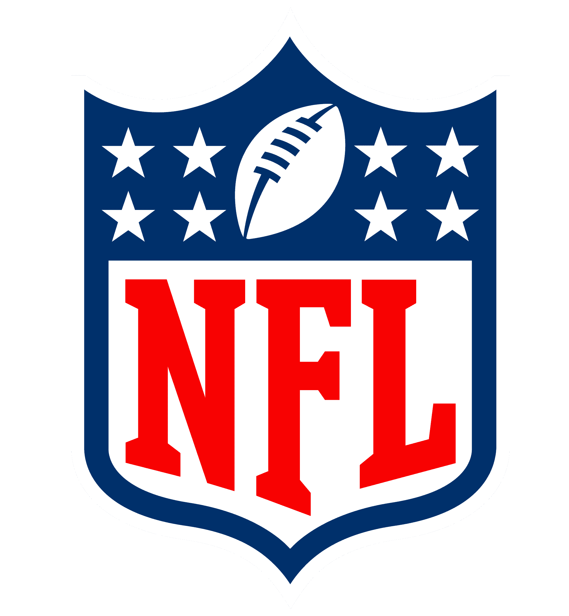
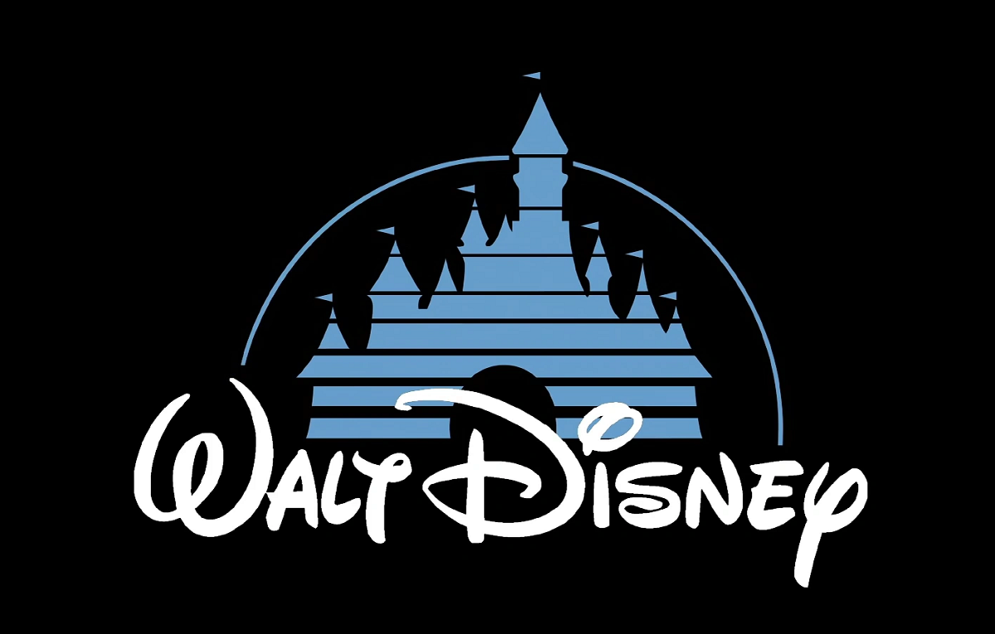

Predict
Vision + Mission
Lay's aims to provide a wide variety of high-quality snacks that bring joy and enjoyment to consumers. The brand emphasizes creating tasty, convenient snacks ………
Application
Use Case
57%
Accuracy
Actual
25%
Precision
100%
Recall
50%
Specificity
40%
F1 score

Slide 19
Key Findings
What People Are Talking About:
Pepsi: Jobs
Coca-Cola: Oreo, zero, bottles
Sentiment: Pepsi < Coca-Cola
Matching Brand Identity:
Our model likely predict Coca-Cola more than Pepsi with 57% accuracy

Slide 20
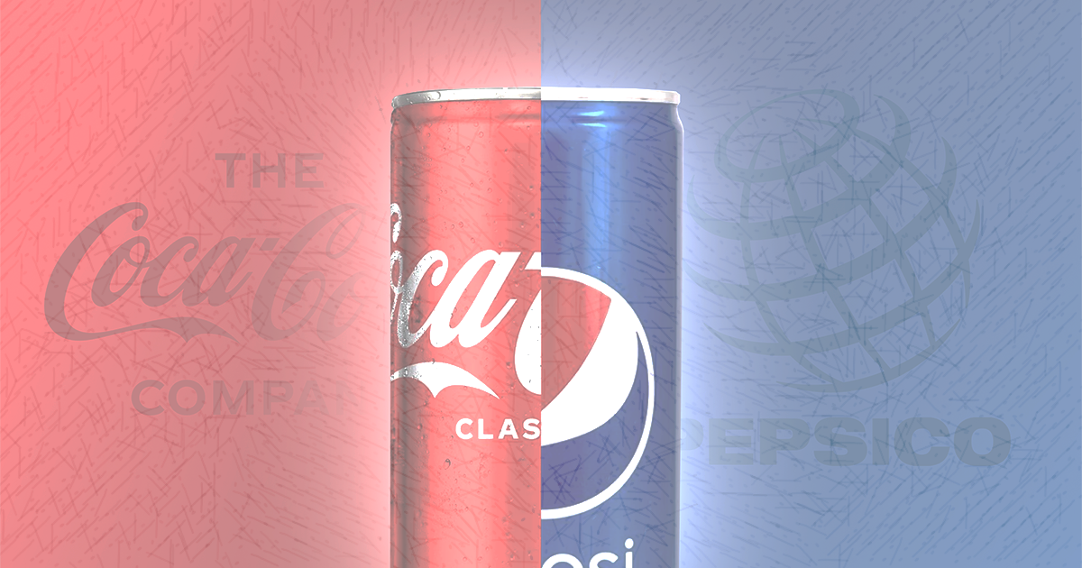
"There's no way Pepsi and Coca-Cola taste the same. It's not just about the beverage—it's about the story, the feeling, moments, and what each brand represents beyond the drink."

